Slide 1
CSE 474 QA
QA Management

Slide 2
5. QA Processes
(V&V, Reviews, Audits)
8. Reviews & Audits
(Tech, Mngt., Inspection, walk-throughs, checklist)
10. Configuration Management
1. Fundamentals & Business Case for Quality Assurance
(IEEE SWBok)
9. Maturity
(CMM, Process, Product, ISO)
11. Risk/Mission Assurance
(Training, CAR, Mitigation)
6. QA Tools
(Fishbone, check, Histograms, Pareto, Scatter, Stratification)]
12. Security/ Legal/ Ethics
(Regulations, Code, Legal, Safety)
2. QA’s Role in SW Lifecycle, Methodologies,
Architecture
[Responsibilities & Roles]
7. QA Attributes
(Verification and Validation )
13 . Project Management
(CoQ, WBS, DevOps )
[VDD, Version, DM, DI]
14. Careers Path
3. QA Techniques
(Dyn, Static, and Testing)
[]
4. Quality Metrics
(Characteristic & Models)
[Measuring]
Know
Do
Become
SWE 474: Quality Assurance Class

Slide 3
Overview
Reading
Assignments
What is the Cost of Quality or the lack of?
Finish the SQAP
Final Version of the SQAP

Slide 4
Reading
L. Westfall Certified Software Quality Engineer Handbook, ASQ Quality Press, 2009-09-01, https://ebookcentral.proquest.com/lib/byui/detail.action?docID=3002591
Chapter 7.1: Methodologies (for Quality Management) (pages 18)
Chapter 15: A. Planning, Scheduling, and Deployment (pages 38)
Chapter 16: B. Tracking and Controlling – Section 1 & 2 (pages 16)
C. Chatfield & T. Johnson, "A Short Course in Project Management," [Online] Available: https://support.office.com/en-us/article/A-short-course-in-project-management-19cfed57-2f85-4a44-aadc-df8482d92688?ui=en-US&rs=en-US&ad=US

Slide 5
What is the Cost of Quality or the lack of?
Task: Create infographic on Cost of Quality
Purpose: Understood the Cost of Quality
Cost of Quality Cost of Quality is like determining the cost of risks and security, Cost of Quality uses an equation and a set of determinant input variables. Cost of Quality consists of the equation that is sum of cost of good quality (appraisal and prevention costs) and poor quality (internal and external failure costs).
Instructions
Step 1: Research each of the part of the Cost of Quality. Provide a summary for:
Good Quality
Appraisal costs
Prevention costs
Poor Quality
Internal costs
External costs
Step 2: Research 3-4 websites and find 20 different examples.
Step 3: Create chart of that displays the difference of the different costs. Identify Quality costs, level, and optimal level.
Step 4: Create an infographic of the information that you found.

Slide 6
Finish the SQAP
Complete the final draft of the SQAP.
You and your team will work on the final draft of the SQAP, have it reviewed and approved by one other groups.
Step 1: Complete all sections of the SQAP
Step 2: Develop a checklist to review the SQAP
Step 3: Perform an internal audit, identify 3-4 defects. Improve checklist. Fix SQAP from defects.
Step 4: Perform one external audits for another group. Identify 3-4 defects from the other team. Identify 3-4 improvements of your checklist. Update checklist.
Step 5: Have an external audit complete for your team’s SQAP. Fix SQAP. Use defects to update checklist.
Submission
Latest version of SQAP
Checklist for SQAP

Slide 7
Final Version of the SQAP
You and your team will work on the final draft of the SQAP, have it reviewed and approved by one other groups.
Complete Step 1 through 5 in the Teach
Step 6: Implement corrections from the audits.
Step 7: Perform an internal audit on your SQAP.
Step 8: Implement findings and provide updated version of the SQAP.
Turn in the following:
Step 1’s version of the SQAP (13.0)
Step 2’s checklist
Checklist document
Step 3’s internal audit
Internal Audit Results document
Updates (SQAP 13.0 -> 13.1)
Step 4’s external audit
Step 5’s review of another group
External Audit Results document
Step 6’s version of the SQAP (13.2)
Updates to SQAP (13.1-> 13.2)
Step 7’s internal audit
Internal Audit Results
Step 8’s Final version of SQAP (13.3)
Update s to SQAP (13.2->13.3)

Slide 9
Reading
L. Westfall Certified Software Quality Engineer Handbook, ASQ Quality Press, 2009-09-01, https://ebookcentral.proquest.com/lib/byui/detail.action?docID=3002591
Chapter 7.1: Methodologies (for Quality Management) (pages 18)
Chapter 15: A. Planning, Scheduling, and Deployment (pages 38)
Chapter 16: B. Tracking and Controlling – Section 1 & 2 (pages 16)
C. Chatfield & T. Johnson, "A Short Course in Project Management," [Online] Available: https://support.office.com/en-us/article/A-short-course-in-project-management-19cfed57-2f85-4a44-aadc-df8482d92688?ui=en-US&rs=en-US&ad=US

Slide 10
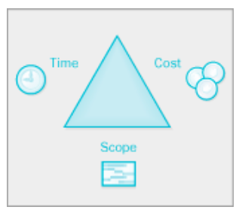
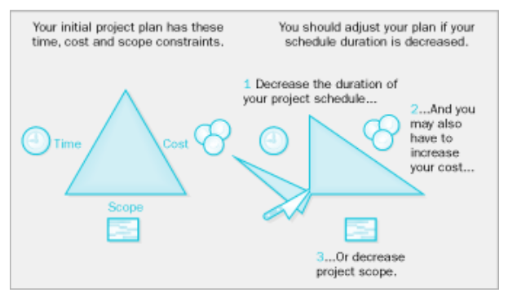
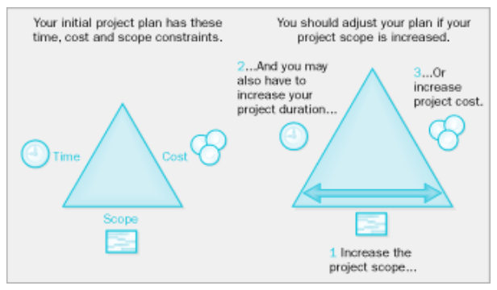
A Short Course in Project Management
Quality
Scope
Cost
Time

Slide 11
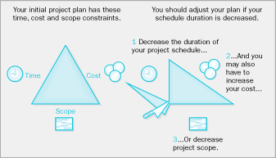
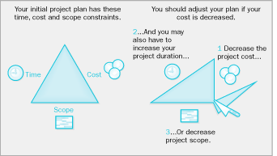
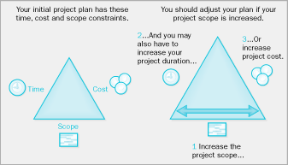
Scope
Cost
Time
Scope
Cost
Scope
Cost
Scope
Cost
Time
Time
Time

Slide 12
1.1 Development constraints
Product Control only four variables:
Cost
Schedule
Quality
Scope
Reason and Constraints
The values for these attributes cannot be set arbitrarily. For any given project, the range of each value is constrained.
Increasing funding to decrease the schedule will actually increase the schedule while increasing the project cost.
It is a closed system
Quality
Pick 3
Scope
Cost
Scope
Cost
?
Time
Time
Scope
Cost
Scope
Cost
Time
Time
Project Uncertainty Principle
If you understand a project, you won’t know its cost, and vice versa.
Dilbert (Scott Adams)

Slide 13
Reading
L. Westfall Certified Software Quality Engineer Handbook, ASQ Quality Press, 2009-09-01, https://ebookcentral.proquest.com/lib/byui/detail.action?docID=3002591
Chapter 7.1: Methodologies (for Quality Management) (pages 18)
Chapter 15: A. Planning, Scheduling, and Deployment (pages 38)
Chapter 16: B. Tracking and Controlling – Section 1 & 2 (pages 16)
C. Chatfield & T. Johnson, "A Short Course in Project Management," [Online] Available: https://support.office.com/en-us/article/A-short-course-in-project-management-19cfed57-2f85-4a44-aadc-df8482d92688?ui=en-US&rs=en-US&ad=US

Slide 14
CSQE Body of Knowledge
Review
I. General Knowledge
D. Leadership Skills
1. Organizational leadership
Use leadership tools and techniques (e.g., organizational change management, knowledge transfer, motivation, mentoring and coaching, recognition). (Apply)
2. Facilitation skills
Use facilitation and conflict resolution skills as well as negotiation techniques to manage and resolve issues. Use meeting management tools to maximize meeting effectiveness. (Apply)
3. Communication skills
Use various communication methods in oral, written, and presentation formats. Use various techniques for working in multicultural environments and identify and describe the impact that culture and communications can have on quality. (Apply)
E. Team Skills
1. Team management
Use various team management skills, including assigning roles and responsibilities, identifying the classic stages of team development (forming, storming, norming, performing, adjourning), monitoring and responding to group dynamics, working with diverse groups and in distributed work environments, and using techniques for working with virtual teams. (Apply)
2. Team tools
Use decision-making and creativity tools such as brainstorming, nominal group technique (NGT), and multi-voting. (Apply)

Slide 15
CSQE Body of Knowledge
II. Software Quality Management (22 questions)
A. Quality Management System
1. Quality goals and objectives
Design software quality goals and objectives that are consistent with business objectives. Incorporate software quality goals and objectives into high-level program and project plans. Develop and use documents and processes necessary to support software quality management systems. (Create)
2. Customers and other stakeholders
Describe and analyze the effect of various stakeholder group requirements on software projects and products. (Analyze)
3. Outsourcing
Determine the impact that outsourced services can have on organizational goals and objectives, and identify criteria for evaluating suppliers/vendors and subcontractors. (Analyze)
4. Business continuity, data protection, and data management
Design plans for business continuity, disaster recovery, business documentation and change management, information security, and protection of sensitive and personal data. (Analyze) [Week 12]
B. Methodologies
1. Cost of quality (COQ) and return on investment (ROI)
Analyze COQ categories (prevention, appraisal, internal failure, external failure) and return on investment (ROI) metrics in relation to products and processes. (Analyze)
2. Process improvement
Define and describe elements of benchmarking, lean processes, the Six Sigma methodology, and use define, measure, act, improve, control (DMAIC) model and the plan-do-check-act (PDCA) model for process improvement. (Apply)
3. Corrective action procedures
Evaluate corrective action procedures related to software defects, process nonconformances, and other quality system deficiencies. (Evaluate)
4. Defect prevention
Design and use defect prevention processes such as technical reviews, software tools and technology, and special training. (Evaluate)

Slide 16
CSQE Body of Knowledge
Review
IV. Project Management
A. Planning, Scheduling, and Deployment
1. Project planning
Use forecasts, resources, schedules, task and cost estimates, etc., to develop project plans. (Apply)
2. Work breakdown structure (WBS)
Use work breakdown structure (WBS) in scheduling and monitoring projects. (Apply)
3. Project deployment
Use various tools, including milestones, objectives achieved, and task duration to set goals and deploy the project. (Apply)

Slide 17
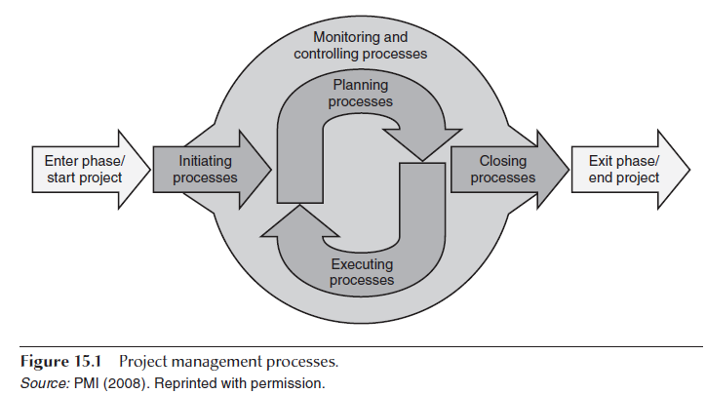
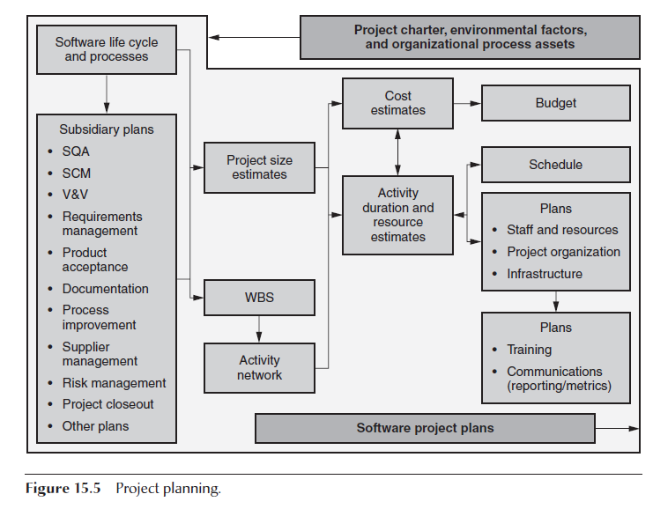
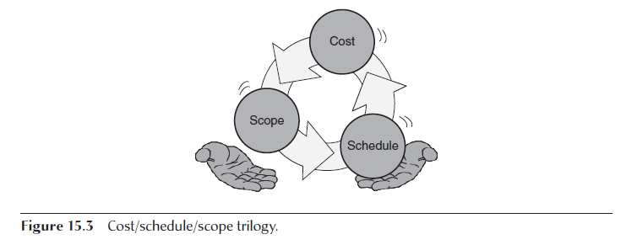
Certified Software Quality Engineer Handbook, Chapter 15 A. Planning, Scheduling, and Deployment
Project Planning

Slide 18
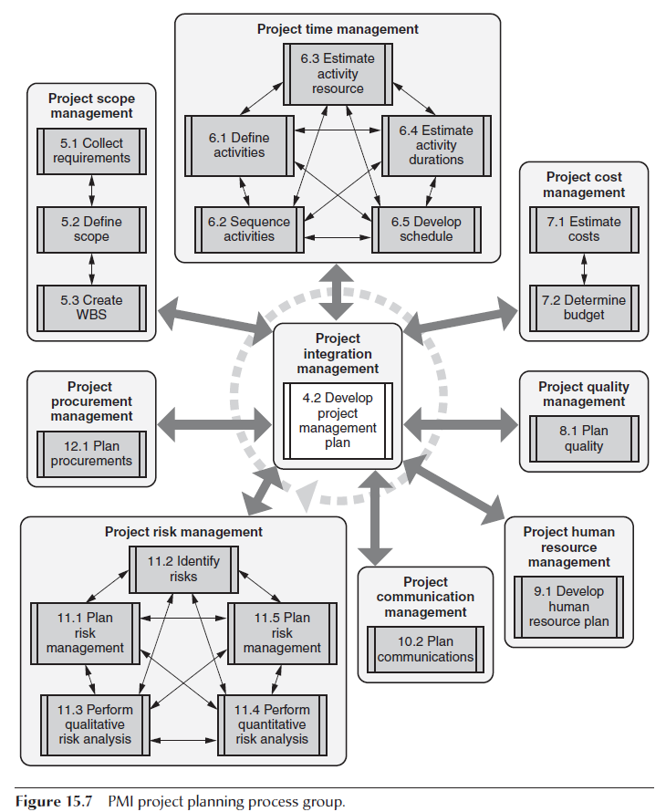
Certified Software Quality Engineer Handbook, Chapter 15 A. Planning, Scheduling, and Deployment - Documents
Project Charter
Environmental Factors and Process Assets
Software Development Life Cycle and Processes
Subsidiary Plans
Software quality assurance (SQA) plan
Software configuration management (SCM) plan
Verification and validation (V&V) plan
Requirements management plan
Product acceptance plan
Documentation plan
Process improvement plan
Supplier management plan
Risk management plan
Project closure plan
Plans
Staff and Resource Plans
Project Organization Plans
Infrastructure Plans
Training Plans
Communication Plans

Slide 19
PMBoK
Cost of quality (COQ).
Cost of quality refers to the total cost of the conformance work and the nonconformance work that should be done as a compensatory effort because, on the first attempt to perform that work, the potential exists that some portion of the required work effort may be done or has been done incorrectly. The costs for quality work may be incurred throughout the deliverable’s life cycle.
For example, decisions made by the project team can impact the operational costs associated with using a completed deliverable.
Post-project quality costs may be incurred because of product returns, warranty claims, and recall campaigns.
Therefore, because of the temporary nature of projects and the potential benefits that may be derived from reducing the post-project cost of quality, sponsoring organizations may choose to invest in product quality improvement.
These investments generally are made in the areas of conformance work that act to prevent defects or act to mitigate the costs of defects by inspecting out nonconforming units.
Refer to Figure 8-2 and Section 8.1.2.2. Moreover, the issues related to postproject COQ should be the concern of program management and portfolio management such that project, program, and portfolio management offices should apply appropriate reviews, templates, and funding allocations for this purpose.

Slide 20
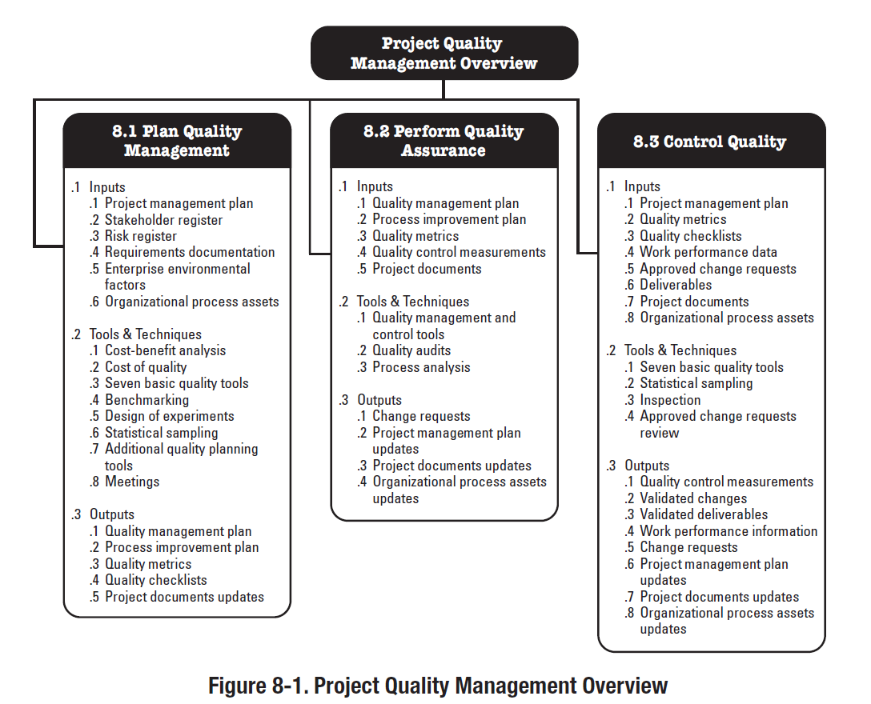
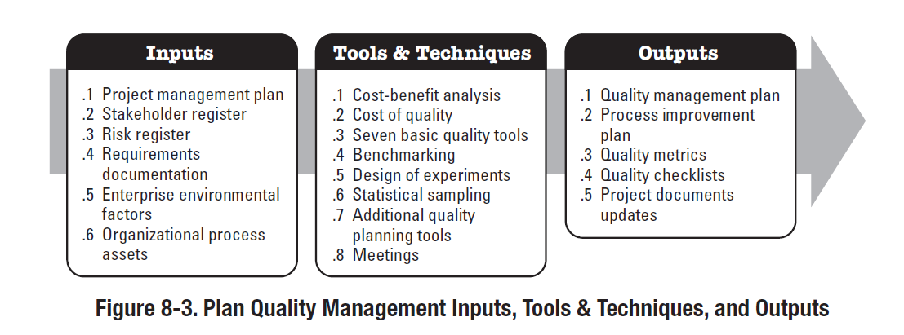
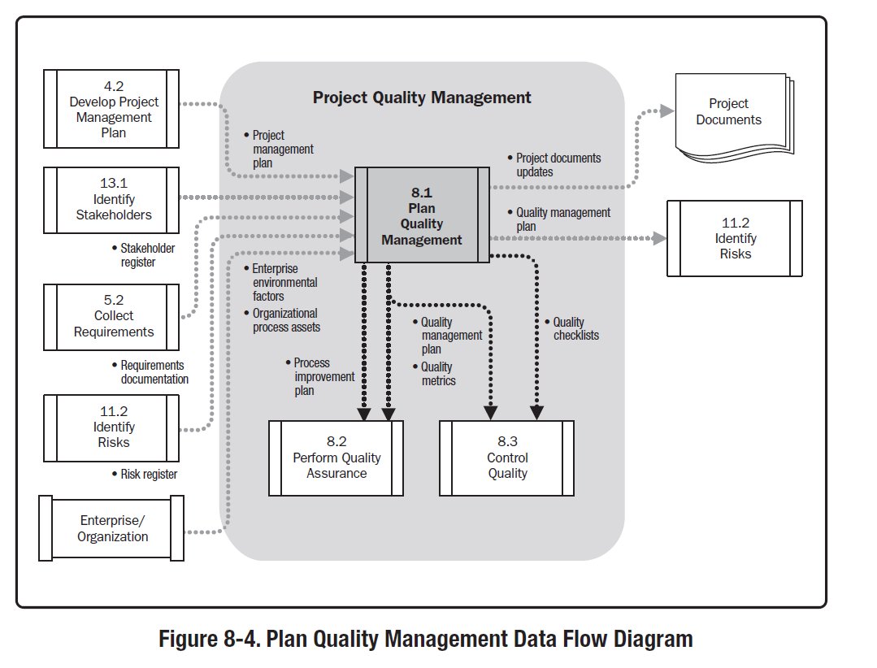
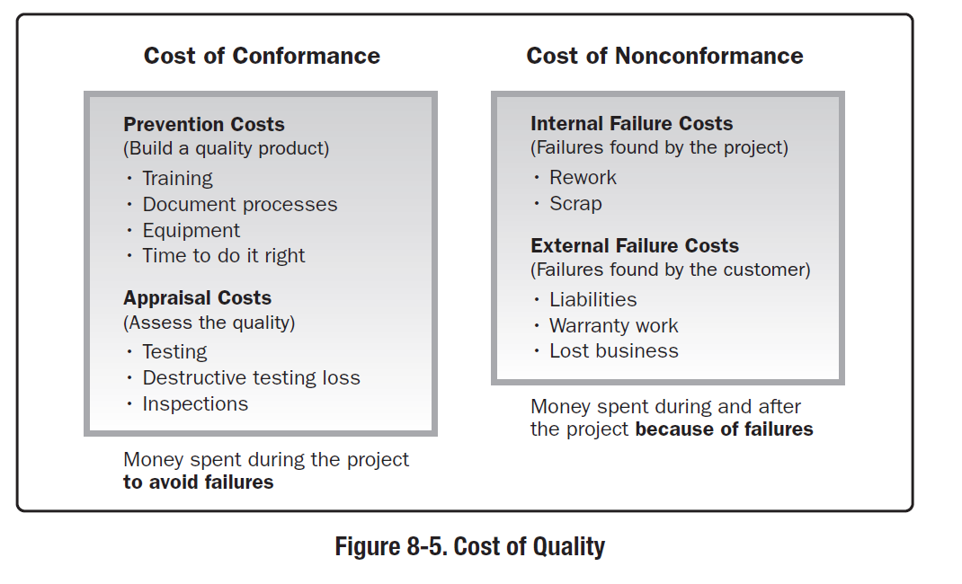
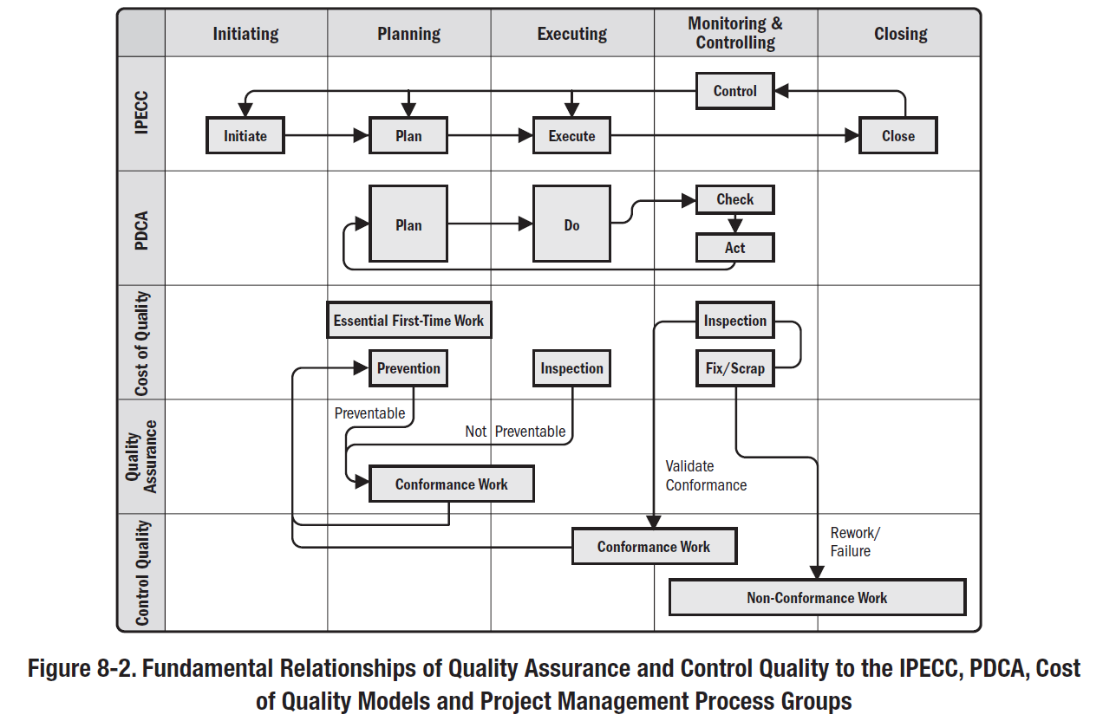
PMBOK,

Slide 21
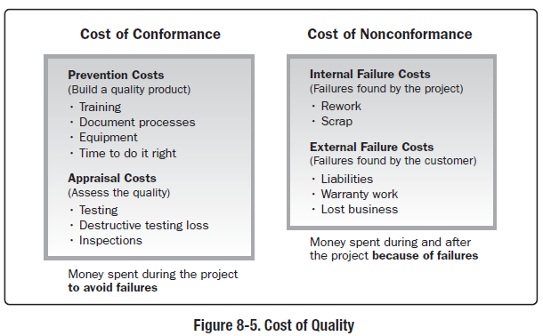
PMBoK
8.1.2.2 Cost of Quality (COQ)
Cost of quality includes all costs incurred over the life of the product by investment in preventing nonconformance to requirements, appraising the product or service for conformance to requirements, and failing to meet requirements (rework).
Failure costs are often categorized into internal (found by the project) and external (found by the customer). Failure costs are also called cost of poor quality. Figure 8-5 provides some examples to consider in each area.
Cost of Quality. A method of determining the costs incurred to ensure quality. Prevention and appraisal costs (cost of conformance) include costs for quality planning, quality control (QC), and quality assurance to ensure compliance to requirements (i.e., training, QC systems, etc.).
Failure costs (cost of nonconformance) include costs to rework products, components, or processes that are non-compliant, costs of warranty work and waste, and loss of reputation.

Slide 22
IEEE Std 1012-2016: IEEE Standard for System, Software, and Hardware Verification, and Validation
7.3 Activity: Supply Planning V&V (Common, 15288—Supply process)
(1) Planning the Interface between the V&V Effort and Supplier
(Coordinating and documenting the interface data and processes with the selected supplier)
a) Review the supplier development plans and schedules to coordinate the V&V effort with development activities.
b) Establish procedures to exchange V&V data and results with the development effort.
c) Coordinate the plan with the supplier.
(2) Contract Verification
Verify the following characteristics of the contract:
a) System requirements (from RFP or tender, and contract) satisfy and are consistent with user needs.
b) Procedures are documented for managing requirement changes and for identifying the management hierarchy to address problems.
c) Procedures for interface and cooperation among the parties are documented, including ownership, warranty, copyright, and confidentiality.
d) Acceptance criteria and procedures are documented in accordance with requirements.

Slide 23
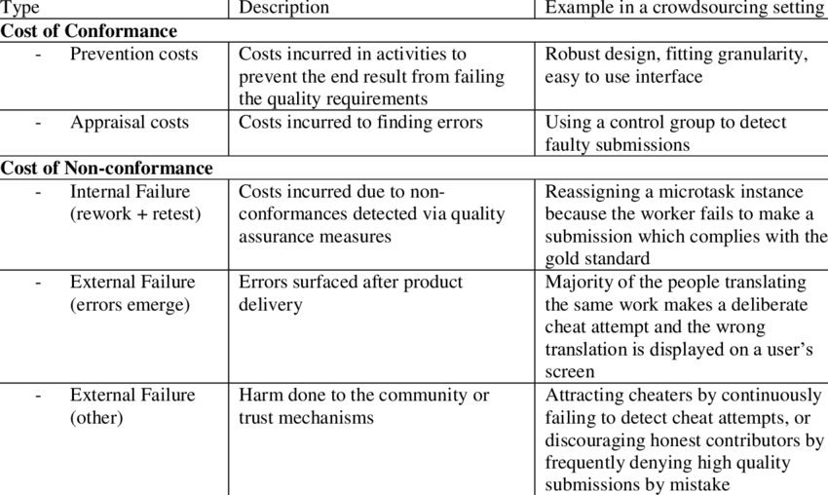
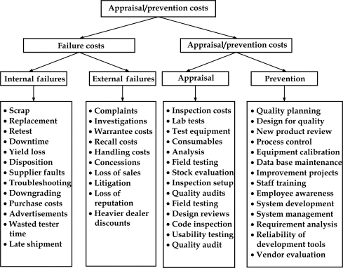
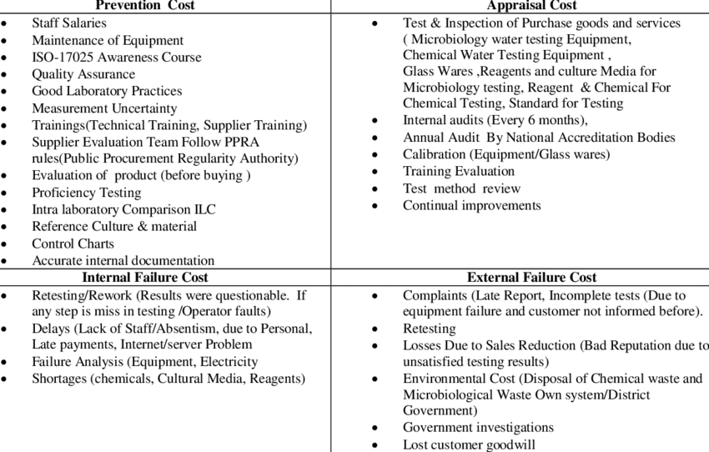

Slide 24
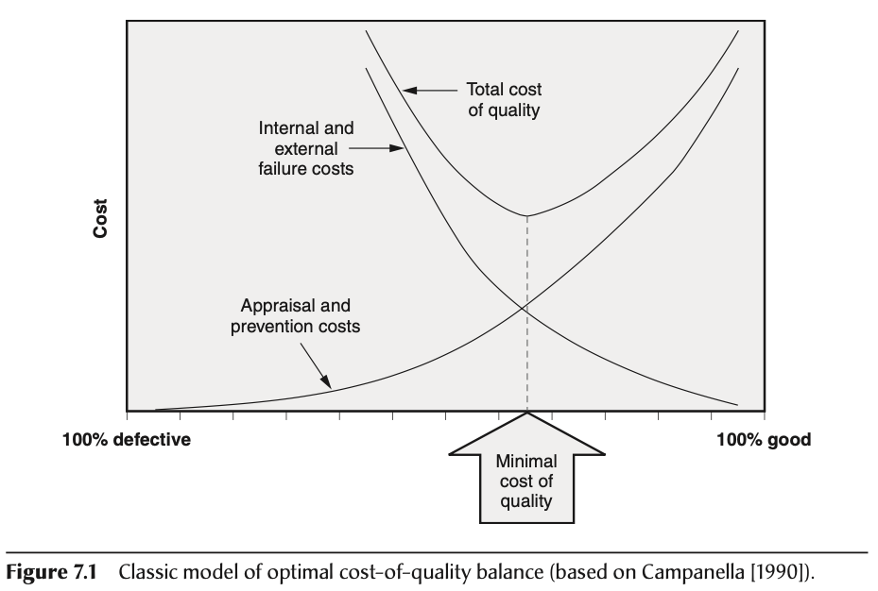
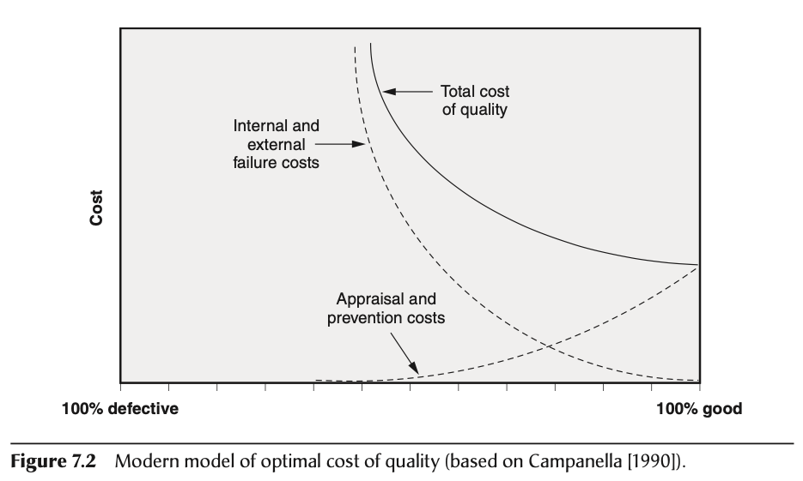
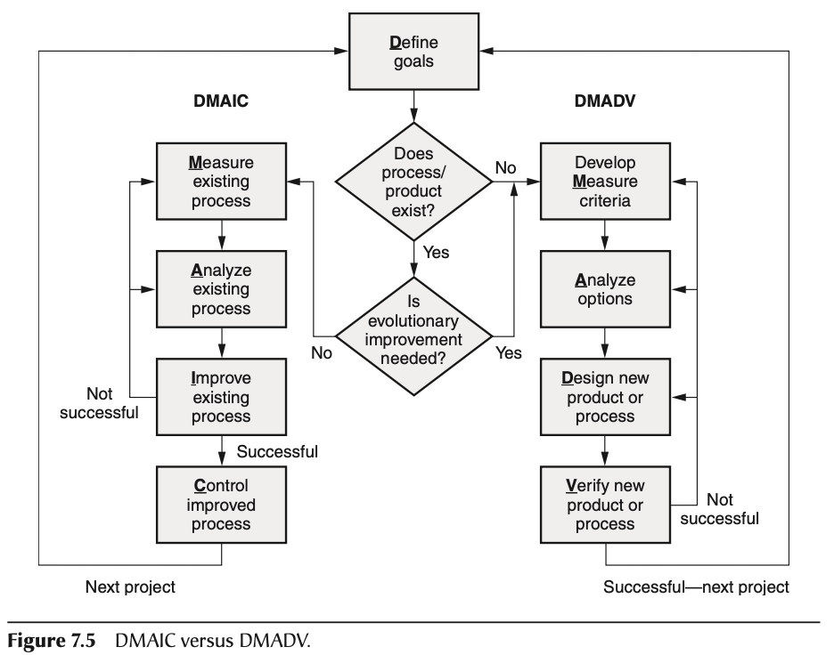
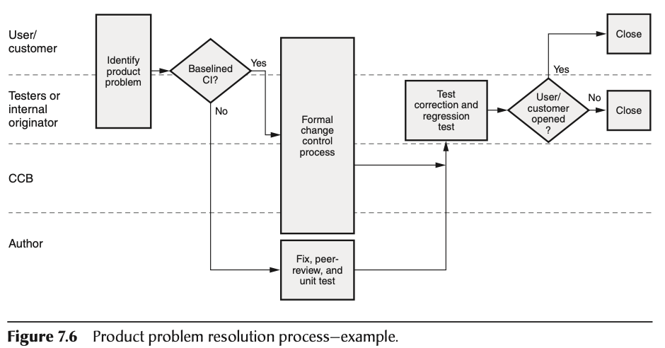
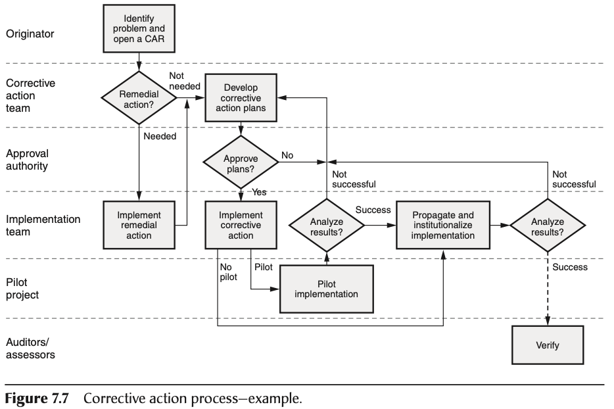
Chapter 7 B. Methodologies (for Quality Management)
1. Cost of Quality (CoQ)
Prevention Cost of Quality
Appraisal Cost of Quality
Internal failure Cost of Quality
External failure Cost of Quality
2. Process Improvement Models
Plan–Do–Check–Act (PDCA) Model
Six Sigma
Lean Techniques
3. Corrective Action Procedures
Product Problem resolution
Corrective Action Process
4. Defect Prevention

Slide 25
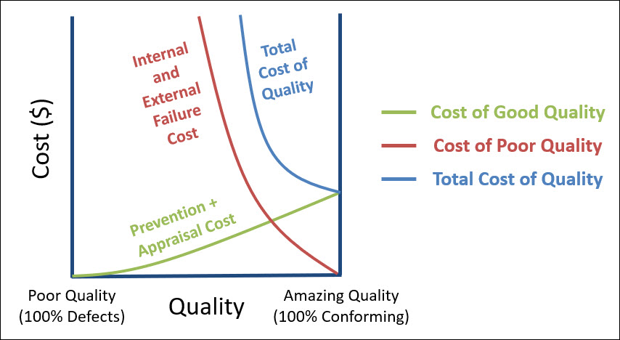
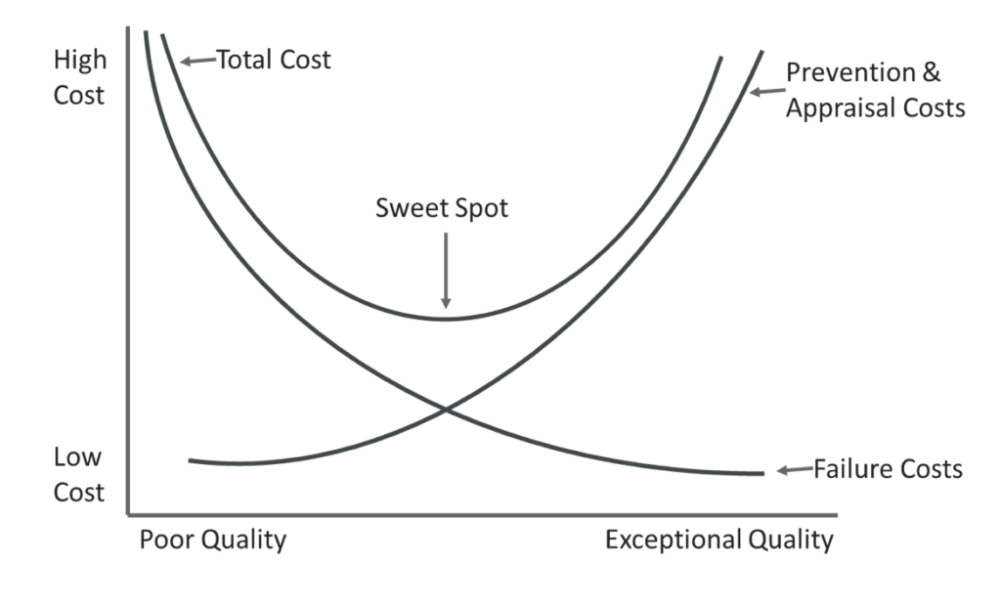
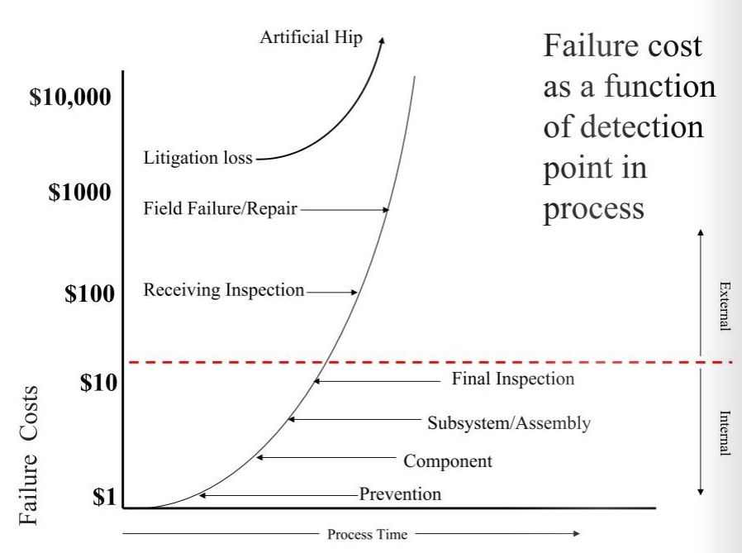
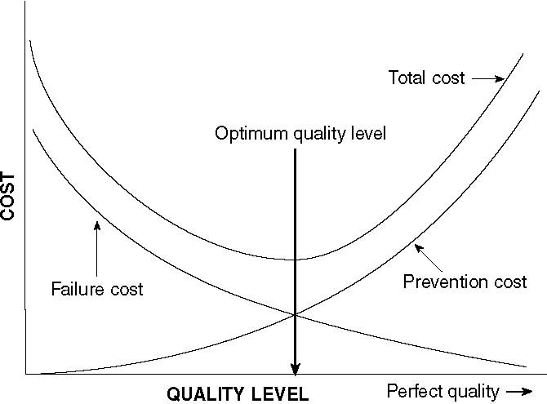
Notes:
https://massaroconsulting.com/2017/10/cost-of-quality/
https://www.isixsigma.com/implementation/financial-analysis/cost-quality-not-only-failure-costs/
https://www.yumpu.com/en/document/read/11718731/cost-of-quality-as-a-driver-for-continuous-systems-quality-
https://qualityamerica.com/LSS-Knowledge-Center/qualitymanagement/goal_of_quality_cost_system.php
https://www.cqeacademy.com/cqe-body-of-knowledge/quality-system/cost-of-quality/

Slide 26
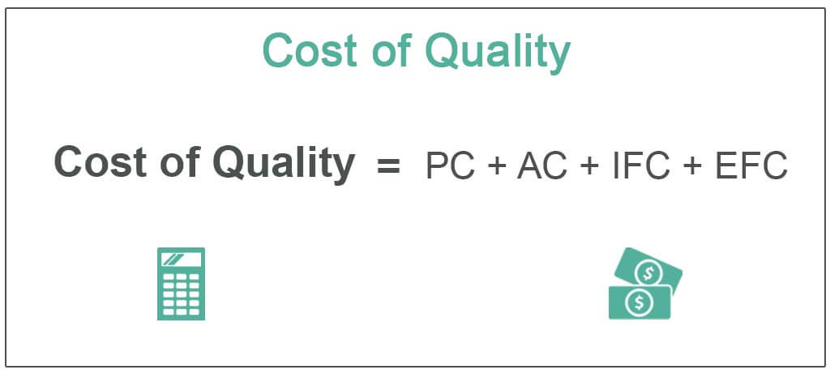
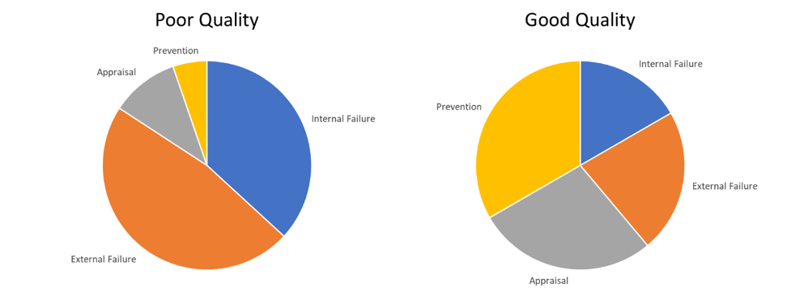
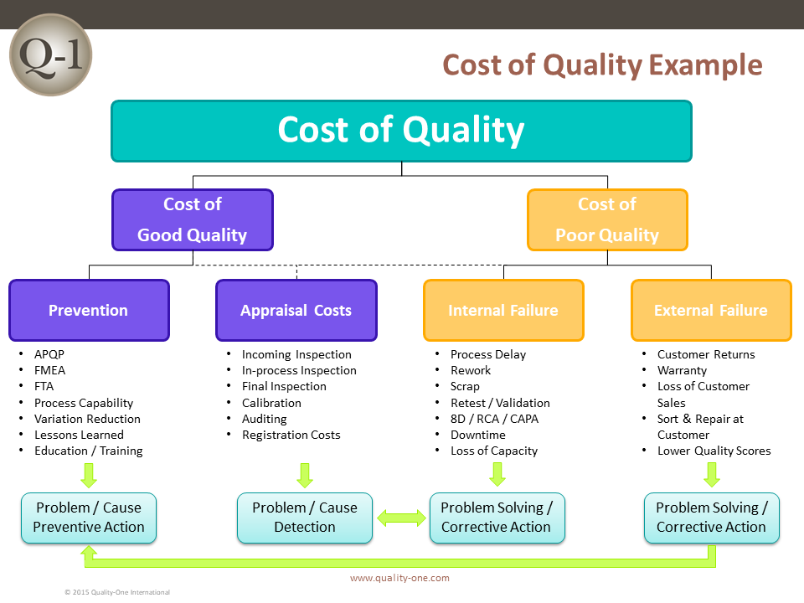
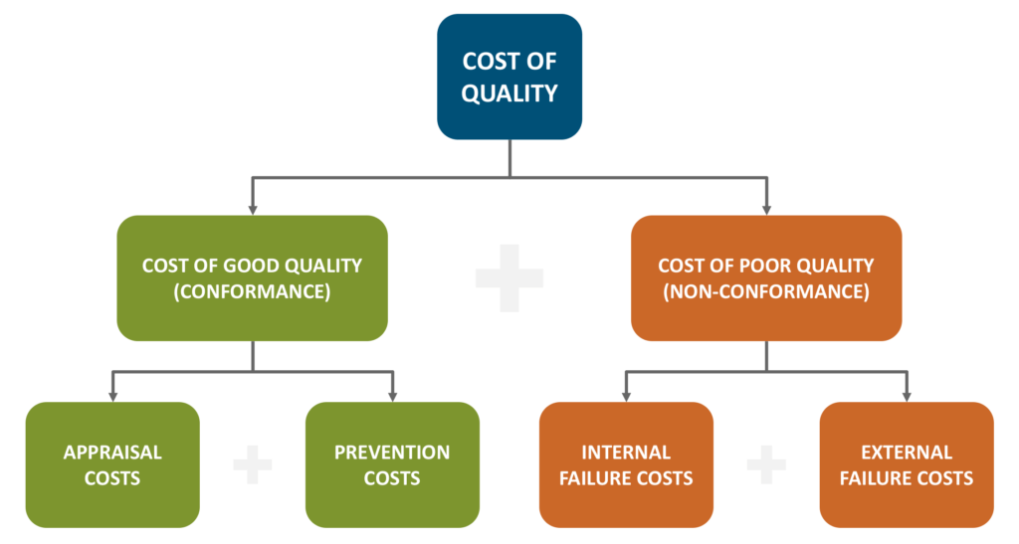

Slide 27
Risk in Estimation

Slide 28
Certified Software Quality Engineer Handbook, Chapter 15 A. Planning, Scheduling, and Deployment - Documents
Project Estimation and Forecasting
Estimation Techniques
Expert-Judgment Estimation Techniques
Model-Based estimation techniques
Budget: Labor, Capital, Other (Subcontract, Supplies, Rents)

Slide 29
Certified Software Quality Engineer Handbook, Chapter 15 A. Planning, Scheduling, and Deployment – Estimation Techniques
Expert-Judgment Estimation Techniques
Agile Poker Planning
Delphi, wideband Delphi
Step 1. Coordinator presents each expert with project specifications and other relevant information.
Step 2. Several experts, in isolation from one another, use their personal experience and judgment to estimate the cost, size, or effort for each activity in the WBS.
Step 3. The coordinator collects the estimates from each expert and prepares a summary of the experts’ responses and their rationales.
Step 4. Each expert receives this composite feedback and is asked to make new predictions based on that feedback.
Step 5. Repeat steps 1 through 4 until consensus is reached that the estimates are close enough to use their average as the estimate.
Step 1: Hand out the cards to participants
Step 2: Read the story out loud
Step 3: Discuss the story
Step 4: Select and share
Step 5: Reach a consensus

Slide 30
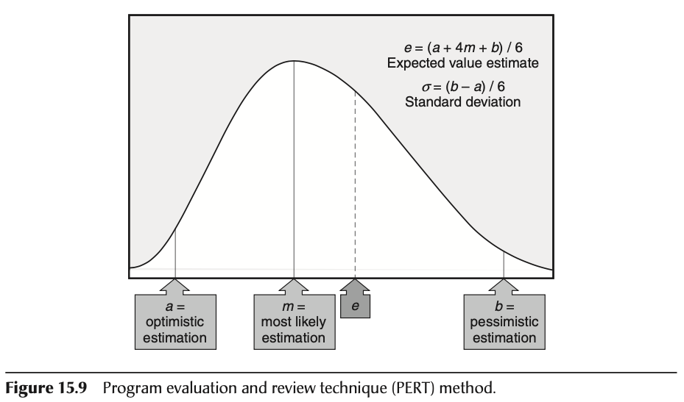
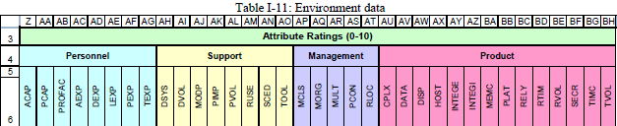
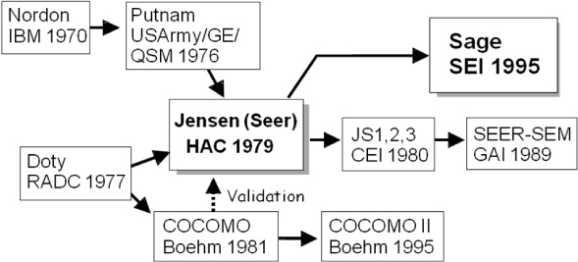
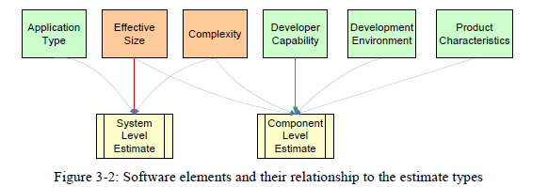
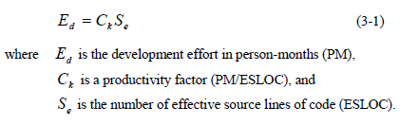
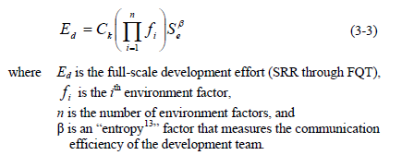
Estimation techniques
Program Evaluation and Review Technique (PERT)
a = most optimistic estimate
m = most likely estimate
b = most pessimistic estimate
Model-Based- COCOMO
Before Design
After Design

Slide 31
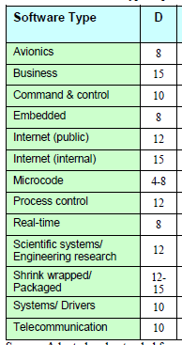
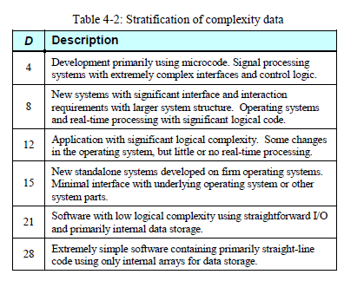
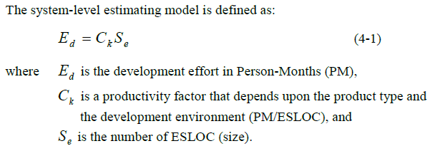
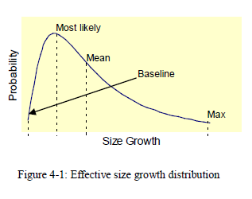
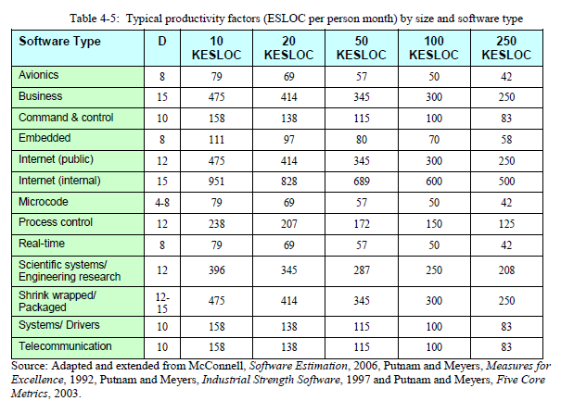
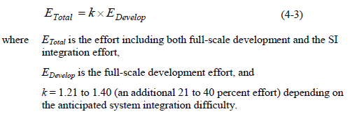
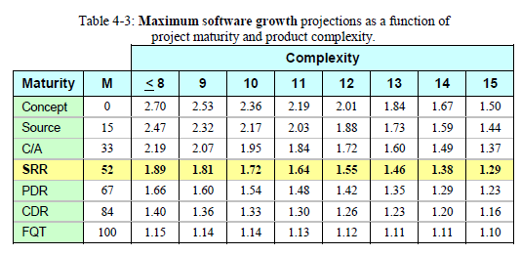
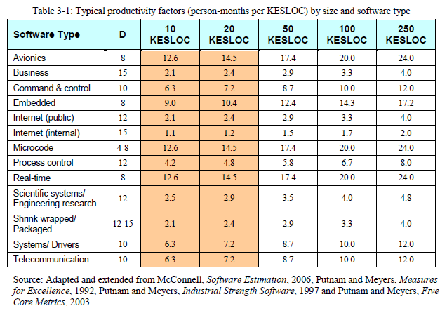
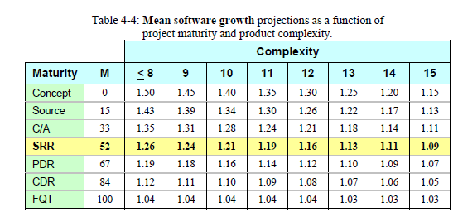
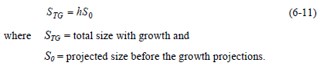
System Est
Se = # of procedures * 2,000
Proc#
S_{e}
D
S_{TG(max)}
E_{d}
E_{Total}
S_{e=}S₀
S_{TG(mean)}
C_{k}
mean
max
h
C_{k}
k=1.28
h
Sum:

Slide 32
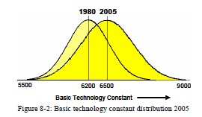
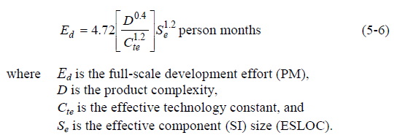



Component Est
Se = # of procedures * 2,000
Proc#
S_{e}
D
S_{TG(max)}
E_{d}
T_{d}
S_{e=}S₀
S_{TG(mean)}
C_{te}

Slide 33





Determining S(ize)
Ftest
Fdes
WAG (Wild awesome guess)
Fimp
Smean
Fdes = reuse / redesign
Fimpl = interface effort/create from scratch
Ftest = retest
Traditional (p75, SAF)
40-20-40
Where S₀ = S_{eff}
S_{TG(max)} = h* S₀
S_{TG(mean)} = h* S₀
S_{mean} = S_{likey} = .707*S_{eff} + .293*S_{max}
Since not bell curve but skewed to the left
Traditional (p75, SAF) 40-20-40

Slide 34









Software Development Cost Estimating Guidebook Chapter 5: Component-Level Estimating Process 5.4 Development environment 5.4.4 Basic technology constant
Determine Complexity
The basic technology constant Ctb describes the developer’s raw capability unaffected by the project environment.
ACAP, AEXP, MODP, PCAP, RESP and TURN are a subset of the environment factors described in detail in Section 8 = Week 11

Slide 35







Certified Software Quality Engineer Handbook, Chapter 15 A. Planning, Scheduling, and Deployment – Estimation Techniques
2. Project Scheduling
Work Breakdown Structure
Activity Networks
Critical Path Method
Scrum
Agile Project Metrics

Slide 36

Certified Software Quality Engineer Handbook, Chapter 15 A. Planning, Scheduling, and Deployment – Estimation Techniques
3. Project Deployment
Project objectives
Business, Cost, Schedule, Milestones,
Product Technical, Product Quality
Organizational, personnel, Contract,
Management Systems
Project Communications
Objectives, Risks, Staff, Location, Agreements, Roles, Responsiblities
Meetings, Cross-Functional, Decisions, Status,
Problem Solving, Metrics

Slide 37

Certified Software Quality Engineer Handbook, Chapter 16 B. Tracking and Controlling
Quality Gates
Gantt Charts
Integrated Master Schedules
Budgets
Project Corrective Action
2. Tracking Methods
Tracking Earned Value

Slide 38




Certified Software Quality Engineer Handbook, Chapter 16 B. Tracking and Controlling
2. Tracking Methods
Tracking Earned Value
Planned value (PV) = the budgeted cost of work scheduled (BCWS)
Earned value (EV) = the budgeted cost of work performed (BCWP)
Actual value (AV) = the actual cost of work performed (ACWP)
Cost variance = BCWP – ACWP
Cost performance index (CPI) = BCWP/ACWP
Schedule variance = BCWP – BCWS
Schedule performance index (SPI) = BCWP/BCWS
Tracking Deliverables
Tracking Productivity
Tracking Resources and Staffing
Selecting Project Metrics

Slide 39













Happy Path Testing
Known path Testing
Expected Path Testing

Slide 40



Certified Software Quality Engineer Handbook, Chapter 16 B. Tracking and Controlling
3. Project Reviews
Phase Gate Reviews
Project Team Reviews
Management Reviews
Post-Project Reviews and Retrospectives
4. Program Reviews

